Slide 1
Middleware

Slide 2
Introduction Mobile Middleware
What is Mobile Middleware
Mobile Middleware for Enterprise
Three major types of middleware
  Adaptation
  Agents
  Service Discovery

Slide 3
Introduction Mobile Middleware
What is Mobile Middleware
Definition
  Middleware is software that supports mediation between other software components, fostering interoperability between those components across heterogeneous platforms and varying resource levels.

Slide 4
Introduction Mobile Middleware –
What is Mobile Middleware
  Mobile middleware allows for the implementation of distributed applications connecting mobile and enterprise applications over wireless networks
Provide the “black box” technology that connects mobile devices on the front lines of the enterprise to the back-end applications running on corporate servers

Slide 5
Middleware for Enterprise
Example Applications
  Wireless email
  Speech middleware
  Firewall and mobile VPN (Virtual Private Network)
  Network connectivity
  Device management
  Enterprise Access
    CRM (Customer Relationship Management)
    EAI (Enterprise Application Integration)
    Enterprise data & information integration
    Insurance Claim

Slide 6
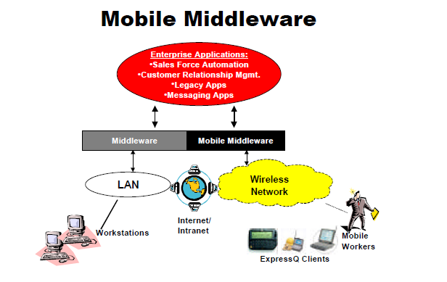
From “Mobile Middleware: The Next Frontier in Enterprise Application Integration” by Tamara Kanoc

Slide 7
Introduction Mobile Middleware
Challenges in developing and deploying a mobile application
  Variety of wireless networks available
  Variety of devices and mobile operating platforms
  Need to communicate with roaming workers
  Disparity between the LAN environment and the mobile environment
  Difficulty in extending enterprise applications into the field
    Security, scalability, reliability, easy integration, multiple network and platform support

Slide 8
Introduction Mobile Middleware
Benefits of mobile middleware
  Speeds development and deployment cycles
  Reduces risk by offering a field proven solution
  Creates application once and run it over any network or device
  Provide efficient and reliable communications
  Mobile middleware also provides
    Guaranteed message delivery
    Push messaging
    Data security
    roaming

Slide 9
Middlewares for Enterprise
Oracle, http://www.oracle.com/index.html
CTO Summit, http://www.oracle.com/events/ctosummit/index.html
  Successful Mobile Strategies, 11 minutes
Mobile Field Service, http://www.oracle.com/applications/service/mobfsrv_cont.html
  enables customer service agents to access and update key information via both hand-held and laptop devices.

Slide 10
Middlewares for Enterprise
Sybase – iAnywhere Solutions,
  Leading provider of mobile enterprise, database and RFID software technology
  http://www.sybase.com/ianywhere
  Mobile Enterprise http://www.sybase.com/products/mobileenterprise
  RFID Anywhere: http://www.sybase.com/products/rfidsoftware/rfidanywhere
    RFID Anywhere is a flexible software infrastructure that integrates business logic and processes with a variety of automatic data collection and sensor technologies, including RFID, barcodes, mobile devices, PLCs, etc.
    Developers and integrators can focus on writing business logic, not low-level hardware interfaces.

Slide 11
Middlewares for Enterprise
Nokia, Mobile Middleware – Nokia Intellisync
http://usa.nokia.com;
Support more than 400 different mobile devices from over 6 different OS
  Palm, Symbian, Windows Mobile, Windows OS, PocketPC, SyncML, BREW
Connect, sync and extend solutions with Microsoft Exchange, Lotus Domino, Novell Groupwise, IMAP/POP3 email interface

Slide 12
Middlewares for Enterprise
IBM
Net’s future is mobile middleware, December 7, 2006, eWeek, http://www.eweek.com/article2/0,1895,2069820,00.asp
  Data-sharing middleware platform for mobile devices
  Code name: Infinity
    based on a number of industry-standard technologies, including XML, HTTP, HTML, JavaScript, and Bluetooth technology

Slide 13
Middlewares for Enterprise
Sprint Campus Connect, http://www.sprint.com/business/
Novell
  Novell GroupWise - http://www.novell.com/groupwise
    a cross-platform collaborative software,
    offering e-mail, calendaring, instant messaging and document management
  Mobility Solutions
    Groupwise Mobile Server
    Blackberry Enterprise Server for Novell Groupwise
SAP
Siebel

Slide 14
Adaptation
Tasks
  Adapt behavior and expectations to conserve scare resources
  Adjust quality of service (QoS) – guarantee performance
How should adaptation be supported?
  Monitor resources
  adapt appropriately
    Typically does not change its core behavior
    Increase or decrease the fidelity of the data

Slide 15
Adaptation
Measures for middleware adaptation strategies
Eg.
1. audio streaming 2. video streaming
3. video gamming contrast while more battery consumption.
  Fidelity
    The degree to which a data item available to an application matches a reference copy
    Perceived quality and consistency
  Agility
    An adaptation middleware’s responsiveness to changes in resource levels
  Concurrency
    Multiple concurrent applications run on the mobile devices

Slide 16
Agents
Allowing programs to move autonomously about a network in order to access remote resources
  Migrate to servers -> access data or computational resources -> migrate again -> return to home base
Benefits
  Disconnection is easily supported
  Access to large amount of data to solve problem
  Allow the functionality of servers to be expanded dynamically
    Without modifying a server’s code

Slide 17
Agents
Examples of mobile codes
  Browsers support Javascript, Java applets
  Applets travel from server to client and are executed on the client
Mobile agents
  Move freely about a network
  Make decisions on where to travel next
  Perform computations and collect data
  Communicate with other agents
  Create new agents

Slide 18
Agents
Mobile agents to search a set of databases
Steps:
  Dispatch agents to database servers or to machines close to the servers
  Agents perform queries against the database servers
  Agents shift the results
  Agents return home and deliver the results
Advantages
  Save the bandwidth
  Continuous network connectivity is not required
  Executed on more powerful computers

Slide 19
Service Discovery
Dynamically discovering and advertising services
Extend the client-server paradigm
  Dynamic discovery of services
  Dynamic interaction between clients and services
Discover needed service on-demand
  E.g., wireless access point, printer
Service Discovery Protocol

